Slide 1
From Data Analyst to Analytics Engineer
With Microsoft Fabric

Slide 2
Fabric February Sponsors

Slide 3
Jon Stjernegaard
voge@inspari.dk
Vöge
/in/jonvoge
Senior Consultant
Downhill-Data.com
Inspari – a valantic company
29 years old, hobby cyclist, puzzle enthusiast and board game nerd.
Microsoft Data Platform MVP
Senior Consultant

Slide 4
Agenda
PART 1: THE ANALYST, THE DATA ANALYST, THE ANALYTICS ENGINEER: A BRIEF HISTORY OF DATA ANALYTICS
PART 2: FABRIC = NEW OPPORTUNITIES
PART 3: A SUGGESTED PATH FOR ASPIRING ANALYTICS ENGINEERS

Slide 5
The Analyst The Engineer The Analytics Engineer

Slide 6
6
Data Analyst
Data Engineer
Analytics Engineer
Clean and prepare data. Filtering, dealing with missing values.
Combine data. Some lightweight feature engineering.
Data Exploration and Analysis
Data Visualization & Reporting
Data Collaboration and Sharing
Extract data from source systems.
Build pipelines to clean, transform and store data in Data Warehouses/Lakehouess.
Architecture design of Data Warehouses/Lakehouses.
Managing metadata.
Tracking and monitoring pipeline stability.
The Link between Business and Platform
Deploy Data Models
Build Data Products
Build and scale Pipelines
Implement software development practices (CI/CD), Version Control
Implement governance measures.
DESCRIPTION
Notes:
OK

Slide 7
7
WHAT DOES
IT-LITERATURE* SAY ABOUT ROLES IN DATA?
*In academia also referred to as the easy to pronounce
‘DSS – Decision Support Systems’ literature
Notes:
OK

Slide 8
8
INSIGHT
Notes:
OK

Slide 9
9
ACTIONABLE
INSIGHT
Notes:
OK

Slide 10
The insight supply chain

Slide 11
Information workers
Information consumers
Business Analysts
No Technical Background
Use Existing Data Products to derive insight and make decisions
Work at the end of the Insight Supply Chain
No Power over the previous steps of the chain

Slide 12
12
I WANT TO EMPOWER MYSELF!
Notes:
OK

Slide 13
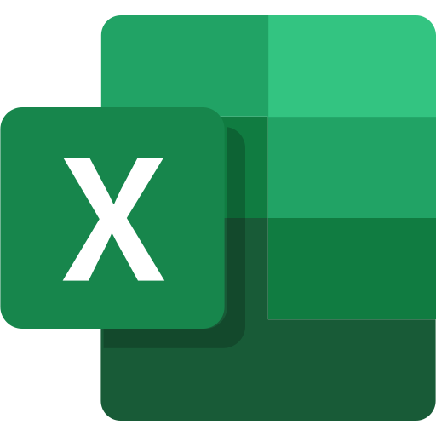

Slide 14
Information workers
Information consumers
Information Producers
Business Analysts
No Technical Background
Use Existing Data Products to derive insight and make decisions
Work at the end of the Insight Supply Chain
No Power over the previous steps of the chain
Analysts empowered with Excel
Traditionally primarily descriptive analysis. Data Visualisation.
Take ownership over early parts of Insight Supply Chain: Sourcing, Prep & Transformation
Lack of automation. Much Technical Debt.

Slide 15
15
I WANT TO EMPOWER OTHERS!
Notes:
OK

Slide 16
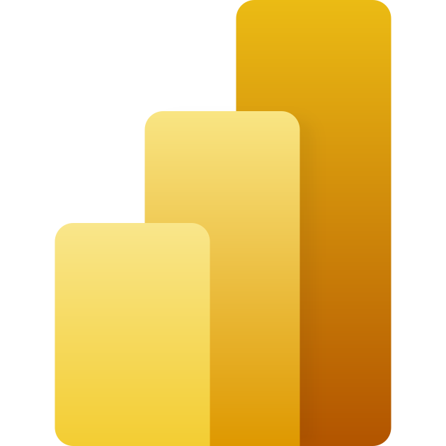

Slide 17
Information workers
Information consumers
Information Producers v2
Business Analysts
No Technical Background
Use Existing Data Products to derive insight and make decisions
Work at the end of the Insight Supply Chain
No Power over the previous steps of the chain
Analysts empowered with Excel & POWER BI
Automated Sourcing, Prepping, Transformation using low-code tools.
Produce and own information. Produce better results downstream.
Take ownership over own deliverables.

Slide 18
18
I WANT TO IMPROVE OUR
DATA FOUNDATION!
Notes:
OK

Slide 19
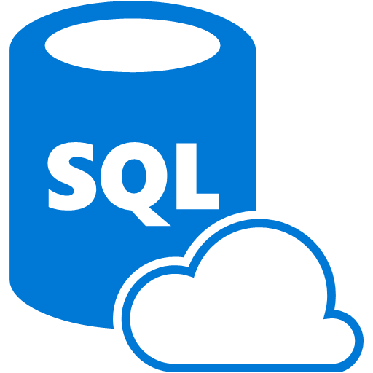

Slide 20
Information workers
Information consumers
Information Producers v2
Information Engineers
Business Analysts
No Technical Background
Use Existing Data Products to derive insight and make decisions
Work at the end of the Insight Supply Chain
No Power over the previous steps of the chain
Analysts empowered with Excel & POWER BI
Automated Sourcing, Prepping, Transformation using low-code tools.
Produce and own information. Produce better results downstream.
Take ownership over own deliverables.
More Technical Background
Use code to Ingest, Transform, Store and serve data.
Automated and optimized for stability, reusability and transparency.
Work at the beginning of the Insight Supply Chain

Slide 21
21
I WANT TO MAKE OUR ORGANIZATION DATA DRIVEN!
Notes:
OK

Slide 22
Information workers
Information consumers
Information Producers v2
Information Engineers
Information Collaborators
Business Analysts
No Technical Background
Use Existing Data Products to derive insight and make decisions
Work at the end of the Insight Supply Chain
No Power over the previous steps of the chain
Analysts empowered with Excel & POWER BI
Automated Sourcing, Prepping, Transformation using low-code tools.
Produce and own information. Produce better results downstream.
Take ownership over own deliverables.
More Technical Background
Use code to Ingest, Transform, Store and serve data.
Automated and optimized for stability, reusability and transparency.
Work at the beginning of the Insight Supply Chain
Innovators who translate business requirements to engineering requirements.
Arranges data from multiple sources and organizes for the analyst.
Connect relevant information across domains.
Values Quality, Reliability and Timeliness

Slide 23
23
HOW DO WE GET THERE?
Notes:
OK

Slide 24
Fabric = New Opportunities & Requirements

Slide 25
Information workers
Information consumers
Information Producers v2
Information Engineers
Information Collaborators
Business Analysts
No Technical Background
Use Existing Data Products to derive insight and make decisions
Work at the end of the Insight Supply Chain
No Power over the previous steps of the chain
Analysts empowered with Excel & POWER BI
Automated Sourcing, Prepping, Transformation using low-code tools.
Produce and own information. Produce better results downstream.
Take ownership over own deliverables.
More Technical Background
Use code to Ingest, Transform, Store and serve data.
Automated and optimized for stability, reusability and transparency.
Work at the beginning of the Insight Supply Chain
Innovators who translate business requirements to engineering requirements.
Arranges data from multiple sources and organizes for the analyst.
Connect relevant information across domains.
Values Quality, Reliability and Timeliness

Slide 27
What we’re hearing from our customers
How do I unify all our disparate sources of data into one single source of truth?
How do I improve democratization of data and insights with easy-to-use analytics tools?
How do I enable faster decision-making with scale, while optimizing governance and cost?
Notes:
Even though data-informed decision-making, BI adoption, and scale are high priority organizational needs––they are not always met. Here’s how Microsoft Fabric can begin to address these challenges.
Creating a unified source of truth ensures organizations are operating in a standardized way – and using the same data across the organization.
Democratization of insights has become an increasingly essential component of decision making. When leveraged correctly, it allows technical – and business – end-users to access, interpret, and use relevant insights for better, more informed decision making.
Every organization is trying to accelerate time to value. A unified source of truth paired with democratized insights enables business end-users to make decisions faster – and with scale. The right solution can also help optimize for governance and costs associated with data and analytics solutions.

Slide 28
Today’s data and analytics challenges
Growing BI adoption to drive a data-driven organization across LOBs and teams
Scaling data and analytics across the organization while reducing costs and optimizing existing data and management
Breaking down data siloes and eliminating unnecessary data sprawl
Making data more accessible to technical and non-technical users in a governed and secure way
Notes:
We’ve talked to a wide range of customers who have led their organizations in data-first modernization. And we understand that businesses today face a variety of data and analytics challenges that can be difficult to navigate.
To put this into perspective, research shows “the amount of data created over the next three years will be more than the data created over the past 30 years.” Accessing and managing real-time data on the cloud is a top priority for long-term success. Investing in a comprehensive data & analytics platform can address the hurdles encountered in your current data ecosystem.
Source: IDC Global DataSphere Forecast, 2020

Slide 29
Modernizing your data and analytics platform is critical for resilient business transformation
Integrated, unified data and governance
Siloed, incomplete data
Technical platform that requires advanced analytics skills
Accessible insights that scale with ease
Costly integration and ongoing maintenance
Transparent, cost-optimized SaaS solution
Notes:
The current state of data, analytics, and business intelligence can be described as being compartmentalized, inaccessible, difficult to draw useful insights from, and costly to oversee.
By using comprehensive data and analytics technology, customers can overcome challenges and gain a competitive advantage:
Instead of working with siloed, incomplete data, a single data & analytics platform can help integrate and unify data, resulting in faster time to insights​.
Now, platforms tend to be technical in nature, requiring advanced skills. An easy-to-use data & analytics platform improves accessibility for business end-users, with the ability to scale powerful insights across the organization.
With multiple data & analytics platforms in use, it can result in slow and costly integrations and ongoing legacy system maintenance. With a single SaaS-based solution, you can save time and costs through simplified, transparent cost management and spend optimization.​

Slide 30
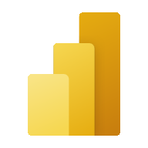
Microsoft Fabric does it all—in a unified solution
An end-to-end analytics platform that brings together all the data and analytics tools that organizations need to go from the data lake to the business user
Data Integration
Data Engineering
Data Warehouse
Data Science
Real Time Analytics
Business Intelligence
Observability
Data Factory
Synapse
Synapse
Synapse
Synapse
Power BI
Data Activator
Unified data foundation
OneLake
UNIFIED
SaaS product experience
Security and governance
Compute and storage
Business model
Notes:
Microsoft Fabric combines Data Factory, Synapse Analytics, Data Explorer, and Power BI into a single, unified experience, on the cloud. The open and governed data lakehouse foundation is a cost-effective and performance-optimized fabric for business intelligence, machine kerning, and AI workloads at any scale. It is the foundation for migrating and modernizing existing analytics solutions, whether this be data appliances or traditional data warehouses.
Talk Track for Greenfield/Growing Analytics Customers – Microsoft Fabric’s SaaS environment makes it easier to deploy an entire end-to-end analytics engine from the ground up at an accelerated pace. With the solution’s built-in security and governance capabilities, you can be rest assured your data and insights are protected.
Talk Track for Existing Synapse Customers – Microsoft Fabric is an evolution of Azure Synapse. You will still be able to enjoy the benefits and limitless scale of Synapse in an easier to use SaaS solution while adopting new capabilities that enhance your entire analytics approach. And with the addition of Power BI, you can help democratize the ability to uncover insights and create interactive reports across the organization, helping everyone make more data-driven decisions in their everyday work.
Talk Track for Existing Power BI Customers – With Microsoft Fabric, you’ll be able to access new and powerful data tools and services like Azure Synapse within the same user experience you already enjoy with Power BI. You can unify these tools with your disparate data sources in the same environment to establish a single source of truth for all data, driving the ability for everyone to uncover more accurate and consistent insights than before. And instead of having to worry about security concerns of a patchwork analytics estate, you can be rest assured your data is protected with the built-in security and governance capabilities.

Slide 31
Information workers
Business Analyst
Data analyst
Data Engineer
Analytics Engineer
Information consumers
Information Producers v2
Information Engineers
Information Collaborators
Business Analysts
No Technical Background
Use Existing Data Products to derive insight and make decisions
Work at the end of the Insight Supply Chain
No Power over the previous steps of the chain
Analysts empowered with Excel & POWER BI
Automated Sourcing, Prepping, Transformation using low-code tools.
Produce and own information. Produce better results downstream.
Take ownership over own deliverables.
More Technical Background
Use code to Ingest, Transform, Store and serve data.
Automated and optimized for stability, reusability and transparency.
Work at the beginning of the Insight Supply Chain
Innovators who translate business requirements to engineering requirements.
Arranges data from multiple sources and organizes for the analyst.
Connect relevant information across domains.
Values Quality, Reliability and Timeliness

Slide 32
What does Microsoft think analytics engineers should know?

Slide 33
DP-600:
Implementing Analytics Solutions Using Microsoft Fabric

Slide 34
Study Guide Topics
Transform data
Implement a data cleansing process
Implement a star schema for a lakehouse or warehouse, including Type 1 and Type 2 slowly changing dimensions
Implement bridge tables for a lakehouse or a warehouse
Denormalize data
Aggregate or de-aggregate data
Merge or join data
Identify and resolve duplicate data, missing data, or null values
Convert data types by using SQL or PySpark
Filter data
Copy data
Choose an appropriate method for copying data from a Fabric data source to a lakehouse or warehouse
Copy data by using a data pipeline, dataflow, or notebook
Implement Fast Copy when using dataflows
Add stored procedures, notebooks, and dataflows to a data pipeline
Schedule data pipelines
Schedule dataflows and notebooks
Plan a data analytics environment
Identify requirements for a solution, including components, features, performance, and capacity stock-keeping units (SKUs)
Recommend settings in the Fabric admin portal
Choose a data gateway type
Create a custom Power BI report theme
Design and build semantic models
Choose a storage mode, including Direct Lake
Identify use cases for DAX Studio and Tabular Editor 2
Implement a star schema for a semantic model
Implement relationships, such as bridge tables and many-to-many relationships
Write calculations that use DAX variables and functions, such as iterators, table filtering, windowing, and information functions
Implement calculation groups, dynamic strings, and field parameters
Design and build a large format dataset
Design and build composite models that include aggregations
Implement dynamic row-level security and object-level security
Validate row-level security and object-level security
Perform exploratory analytics
Implement descriptive and diagnostic analytics
Integrate prescriptive and predictive analytics into a visual or report
Profile data
Implement and manage a data analytics environment
Implement workspace and item-level access controls for Fabric items
Implement data sharing for workspaces, warehouses, and lakehouses
Manage sensitivity labels in semantic models and lakehouses
Configure Fabric-enabled workspace settings
Manage Fabric capacity and configure capacity settings
Optimize enterprise-scale semantic models
Implement performance improvements in queries and report visuals
Improve DAX performance by using DAX Studio
Optimize a semantic model by using Tabular Editor 2
Implement incremental refresh
Manage the analytics development lifecycle
Implement version control for a workspace
Create and manage a Power BI Desktop project (.pbip)
Plan and implement deployment solutions
Perform impact analysis of downstream dependencies from lakehouses, data warehouses, dataflows, and semantic models
Deploy and manage semantic models by using the XMLA endpoint
Create and update reusable assets, including Power BI template (.pbit) files, Power BI data source (.pbids) files, and shared semantic models
Query data by using SQL
Query a lakehouse in Fabric by using SQL queries or the visual query editor
Query a warehouse in Fabric by using SQL queries or the visual query editor
Connect to and query datasets by using the XMLA endpoint
Create objects in a lakehouse or warehouse
Ingest data by using a data pipeline, dataflow, or notebook
Create and manage shortcuts
Implement file partitioning for analytics workloads in a lakehouse
Create views, functions, and stored procedures
Enrich data by adding new columns or tables
Optimize performance
Identify and resolve data loading performance bottlenecks in dataflows, notebooks, and SQL queries
Implement performance improvements in dataflows, notebooks, and SQL queries
Identify and resolve issues with the structure or size of Delta table files (including v-order and optimized writes)

Slide 35
A little overwhelming...?

Slide 36
ROADMAP FOR ASPIRING ANALYTICS ENGINEERS

Slide 37
So where does an Analyst begin?

Slide 38
Let’s condense it to just the headlines
Copy data
Design and build semantic models
Optimize enterprise-scale semantic models
Manage the analytics development lifecycle
Implement a data analytics environment
Plan a data analytics environment
Transform Data
Query data by using SQL
Perform exploratory analytics
Create objects in a lakehouse or warehouse
Optimize performance

Slide 39
And have a quick look at the more digestible audience description

Slide 40
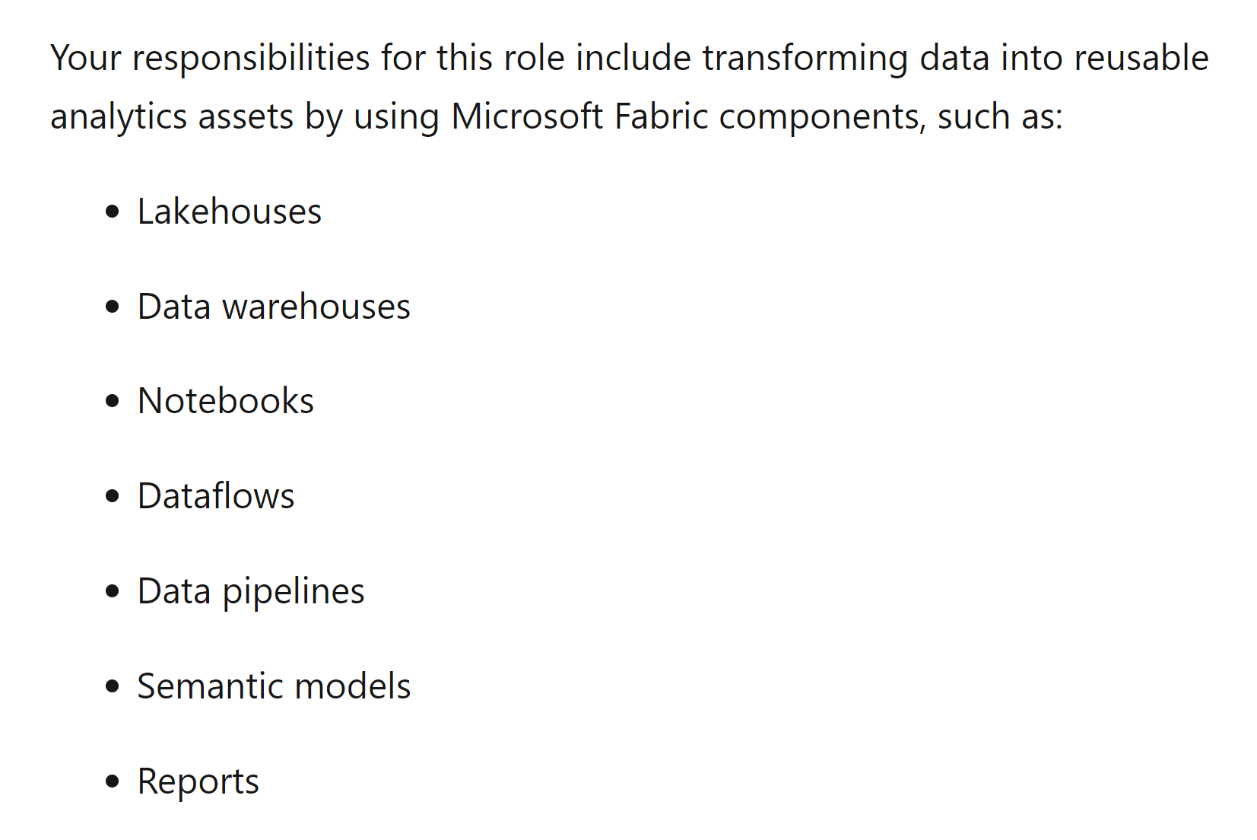

Slide 41
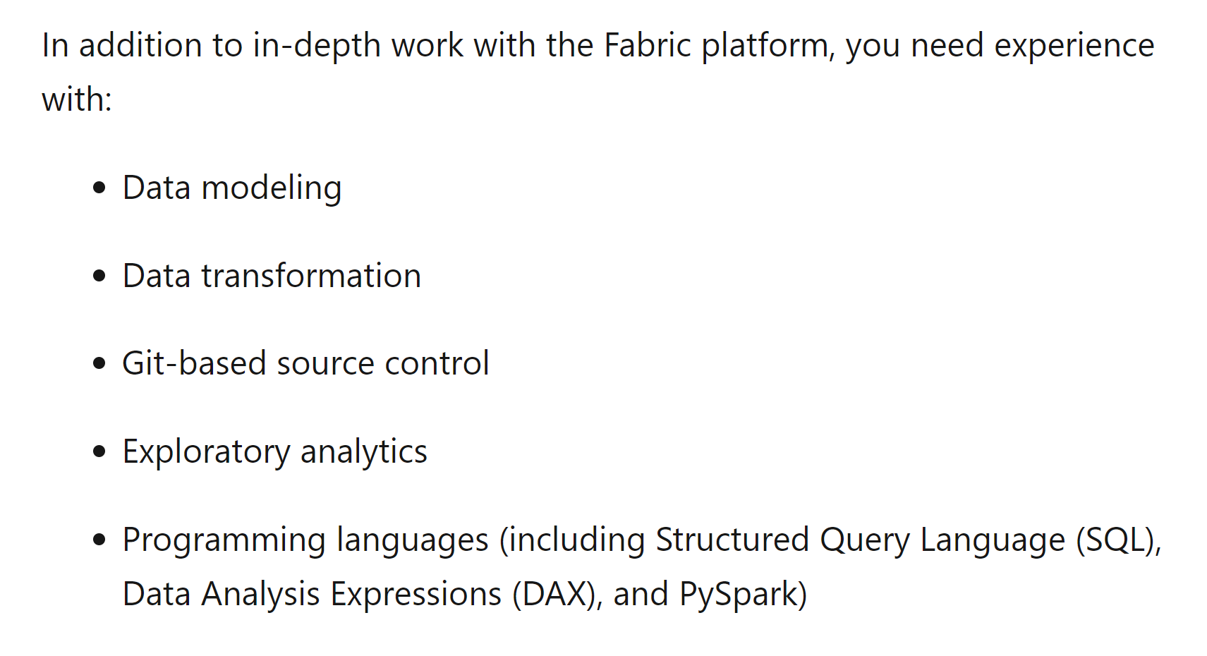

Slide 42
And we can turn the topics into a simplified roadmap
Copy data
Design and build semantic models
Optimize enterprise-scale semantic models
Manage the analytics development lifecycle
Implement a data analytics environment
Plan a data analytics environment
Transform Data
Query data by using SQL
Perform exploratory analytics
Create objects in a lakehouse or warehouse
Optimize performance

Slide 43
The good thing is… We can get very, very far starting with stuff we already know. Or tangential to stuff we know.

Slide 44
Stuff we as Power bi people know already…
Dataflows for Data Ingestion
Best Practice Semantic Modeling
Report performance optimization

Slide 45
Project #1: Low code end-to-end solution
Use dataflow Gen2 to ingest data
Use a data source you find interesting. Perhaps an open API? Or a Private if you are feeling adventurous…
Store data in Warehouse / Lakehouse
Don’t be afraid of the whole SPARK/SQL thing… You probably don’t need it for a personal project…
Build your first direct lake model
Create a Custom Semantic Model using Direct Lake, and familiarize with the concepts.

Slide 46
Copy data
Choose an appropriate method for copying data from a Fabric data source to a lakehouse or warehouse
Copy data by using a data pipeline, dataflow, or notebook
Implement Fast Copy when using dataflows
Add stored procedures, notebooks, and dataflows to a data pipeline
Schedule data pipelines
Schedule dataflows and notebooks
Design and build semantic models
Choose a storage mode, including Direct Lake
Identify use cases for DAX Studio and Tabular Editor 2
Implement a star schema for a semantic model
Implement relationships, such as bridge tables and many-to-many relationships
Write calculations that use DAX variables and functions, such as iterators, table filtering, windowing, and information functions
Implement calculation groups, dynamic strings, and field parameters
Design and build a large format dataset
Design and build composite models that include aggregations
Implement dynamic row-level security and object-level security
Validate row-level security and object-level security
Optimize enterprise-scale semantic models
Implement performance improvements in queries and report visuals
Improve DAX performance by using DAX Studio
Optimize a semantic model by using Tabular Editor 2
Implement incremental refresh

Slide 47
We can Pretty Quickly check off the first boxes
Copy data
Design and build semantic models
Optimize enterprise-scale semantic models
Manage the analytics development lifecycle
Implement a data analytics environment
Plan a data analytics environment
Transform Data
Query data by using SQL
Perform exploratory analytics
Create objects in a lakehouse or warehouse
Optimize performance

Slide 48
And If we add a little bit of Platform Administration & development practices
Understanding capacities and licences
Implementing capacity & workspace strategy
Content lifecycle management practices

Slide 49
Project #2: collaboration, Deployment & External Tools
Learn about collaborative development
Using your previous project as a guinea pig, employ a multi workspace strategy. Try out GIT Versioning, Branching and Deployment Pipelines.
If Possible: Gain access to ADMIN Settings
Enable Read/Write XMLA Endpoint for your capacity. Also check out the other settings to get an understanding of possibilities
Connect from external tools
Try connecting to your Semantic Model & Lakehouse/Warehouse endpoint from external tools like SSMS, Tabular Editor and ALM Toolkit. Also try out some of the built-in Capacity Monitoring tools.

Slide 50
Plan a data analytics environment
Identify requirements for a solution, including components, features, performance, and capacity stock-keeping units (SKUs)
Recommend settings in the Fabric admin portal
Choose a data gateway type
Create a custom Power BI report theme
Implement and manage a data analytics environment
Implement workspace and item-level access controls for Fabric items
Implement data sharing for workspaces, warehouses, and lakehouses
Manage sensitivity labels in semantic models and lakehouses
Configure Fabric-enabled workspace settings
Manage Fabric capacity and configure capacity settings
Manage the analytics development lifecycle
Implement version control for a workspace
Create and manage a Power BI Desktop project (.pbip)
Plan and implement deployment solutions
Perform impact analysis of downstream dependencies from lakehouses, data warehouses, dataflows, and semantic models
Deploy and manage semantic models by using the XMLA endpoint
Create and update reusable assets, including Power BI template (.pbit) files, Power BI data source (.pbids) files, and shared semantic models

Slide 51
We are more than halfway there!
Copy data
Design and build semantic models
Optimize enterprise-scale semantic models
Manage the analytics development lifecycle
Implement a data analytics environment
Plan a data analytics environment
Transform Data
Query data by using SQL
Perform exploratory analytics
Create objects in a lakehouse or warehouse
Optimize performance

Slide 52
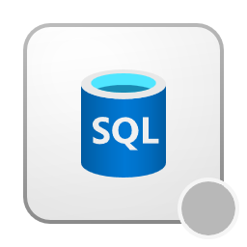
Perhaps you already know a bit of sql? Sql in a fabric context is a logical next step.
Data warehouse setup & data transformation
Pipelines for ingestion, SQL for querying data
Exploratory analysis with sql

Slide 53
Project #3: pipelines and warehouses
Try out data pipelines for ingesting data
Data Pipelines are not that hard to get started with. Start out with some of the sample data or try with your own data.
Transform data in a warehouse
While Warehouses are not the most frequently recommended Fabric Storage, they are easy to use. Especially if you are used to SQL, Stored Procedures and Views.
Explore your data with sql
Explore the possibilities and limitations of T-SQL in Fabric Data Warehouses. Time Travel? Cloning? Primary Keys?

Slide 54
Transform data
Implement a data cleansing process
Implement a star schema for a lakehouse or warehouse, including Type 1 and Type 2 slowly changing dimensions
Implement bridge tables for a lakehouse or a warehouse
Denormalize data
Aggregate or de-aggregate data
Merge or join data
Identify and resolve duplicate data, missing data, or null values
Convert data types by using SQL or PySpark
Filter data
Query data by using SQL
Query a lakehouse in Fabric by using SQL queries or the visual query editor
Query a warehouse in Fabric by using SQL queries or the visual query editor
Connect to and query datasets by using the XMLA endpoint
Perform exploratory analytics
Implement descriptive and diagnostic analytics
Integrate prescriptive and predictive analytics into a visual or report
Profile data

Slide 55
Just a little more left…
Copy data
Design and build semantic models
Optimize enterprise-scale semantic models
Manage the analytics development lifecycle
Implement a data analytics environment
Plan a data analytics environment
Transform Data
Query data by using SQL
Perform exploratory analytics
Create objects in a lakehouse or warehouse
Optimize performance

Slide 56
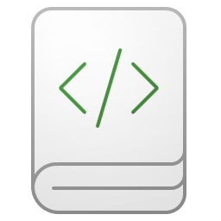
And finally, it is time to tackle lakehouses and python
Lakehouses, shortcuts & partitioning
Notebooks, python and performance optimization

Slide 57
Project #4: Friendship ended with Warehouses… Now Lakehouses and Notebooks are my best friends
From warehouse to lakehouse
Try converting an existing project using a warehouse into one using a lakehouse. Use Chat GPT to convert your T-SQL into SparkSQL and try it in a Notebook.
Create a Medallion architecture
Create multiple Lakehouses, and use Notebooks to transform and persist data into multiple stages.
Explore other notebook functionality
Notebooks are crazy. Daunting but powerful. Try out Semantic Link for your Semantic Models, or using the API for metadata and usage insights.

Slide 58
Create objects in a lakehouse or warehouse
Ingest data by using a data pipeline, dataflow, or notebook
Create and manage shortcuts
Implement file partitioning for analytics workloads in a lakehouse
Create views, functions, and stored procedures
Enrich data by adding new columns or tables
Optimize performance
Identify and resolve data loading performance bottlenecks in dataflows, notebooks, and SQL queries
Implement performance improvements in dataflows, notebooks, and SQL queries
Identify and resolve issues with the structure or size of Delta table files (including v-order and optimized writes)

Slide 59
and we should now be ready for DP-600…?
Copy data
Design and build semantic models
Optimize enterprise-scale semantic models
Manage the analytics development lifecycle
Implement a data analytics environment
Plan a data analytics environment
Perform exploratory analytics
Query data by using SQL
Transform Data
Create objects in a lakehouse or warehouse
Optimize performance

Slide 60
It is impossible to know everything.
Start with the stuff that comes most natural to an you…

Slide 61
And in no time:

Slide 62
If Time: Examples of an analyst (me) trying to take on fabric

Slide 63
Questions?
feel Free to connect with me. LinkedIn: https://www.linkedin.com/in/jonvoge/ Sessionize: https://sessionize.com/jon-voge Download presentation material from github: https://github.com/Jonvoge/speaker-material

Slide 64
Fabric February Feedback

